Slide 1



Real Time Gesture Detection Using Convolutional Neural Network
Under The Guidance of: Prof. Pooja Jain

Slide 2
What is Convolutional Neural Network?
A Convolutional Neural Network (ConvNet/CNN) is a Deep Learning algorithm which can take in an input image, assign importance (learnable weights and biases) to various aspects/objects in the image and be able to differentiate one from the other.

Slide 3
What is gesture recognition?
The ability of a computer to understand gestures and execute commands based on those gestures.
Gesture recognition is useful in processing information that cannot be conveyed through speech or text.
This could be used to control computer input and detect sign language and for active gameplay.
The implementation of this system mainly consists of 3 phases: Learning, Detection, Recognition

Slide 4
Learning:
It involves two aspects such as:
Training dataset: This is the dataset that consists of different types of hand gestures that are used to train the system based on which the system performs the actions.
Feature Extraction: It involves determining the centroid that divides the image into two halves at its geometric Centre

Slide 5
Detection:
Capture scene: Captures the images through a web camera, which is used as an input to the system.
Preprocessing: Images that are captured through the webcam are compared with the dataset to recognize the valid hand movements that are needed to perform the required actions.
Hand Detection: The requirements for hand detection involve the input image from the webcam. The image should be fetched with a speed of 20 frames per second. Distance should also be maintained between the hand and the camera. The approximate distance that should be between hand the camera is around 30 to 100 cm. The video input is stored frame by frame into a matrix after preprocessing.

Slide 6
Recognition:
It involves two aspects such as:
Gesture Recognition: The number of fingers present in the hand gesture is determined by making use of defect points present in the gesture. The resultant gesture obtained is fed through a 3-Dimensional Convolutional Neural Network consecutively to recognize the current gesture.
Performing action: The recognized gesture is used as an input to perform the actions required by the user.

Slide 7
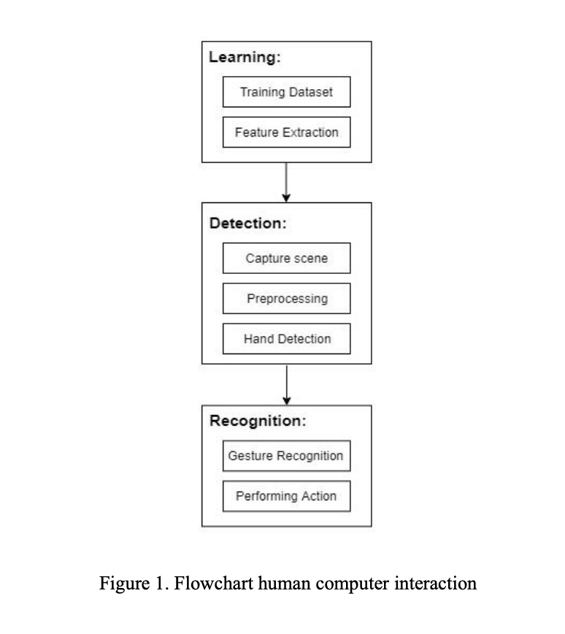

Slide 8
Level : 1
Implementation approach:
STEP - 1:
  Using TensorFlow.js "handpose" model to detect the hand landmarks inside the video picture.
STEP - 2:
  Using Fingerpose library for Estimating the direction and curl of each individual finger
STEP - 3:
  Using Fingerpose library again for Comparing the result to a set of gesture descriptions

Slide 9
TenserFlow.js Handpose model
Given an input, the model predicts whether it contains a hand
Palm Detection Model : To detect initial hand locations, we designed a single-shot detector model(used for detecting using single deep neural network).since estimating bounding boxes of rigid objects like palms and fists is significantly simpler than detecting hands with articulated fingers.
Hand Landmark Model : To perform a precise keypoint localization of 21 3D hand-knuckle coordinates inside the detected hand regions via regression, that is direct coordinate prediction.
This model is a part of MediaPipe, a framework for building multimodal applied ML pipelines.

Slide 10
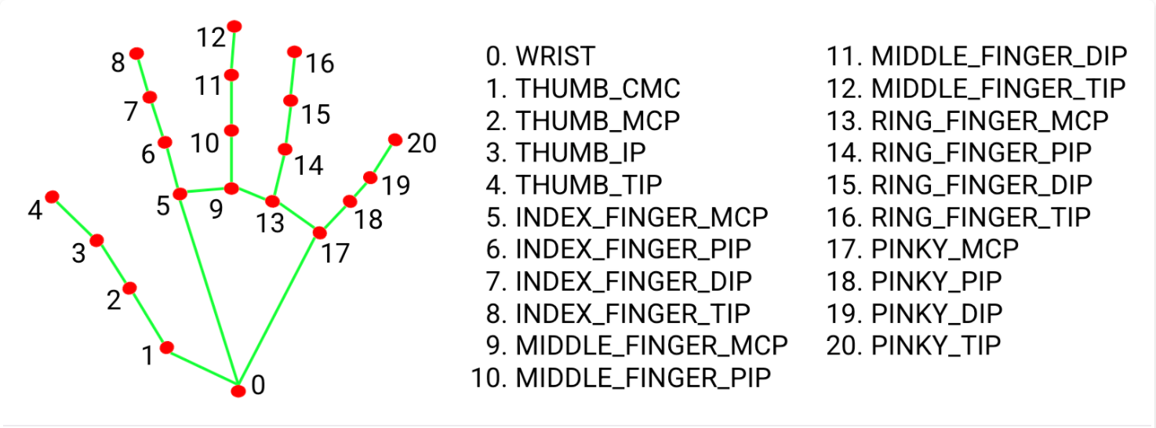

Slide 11
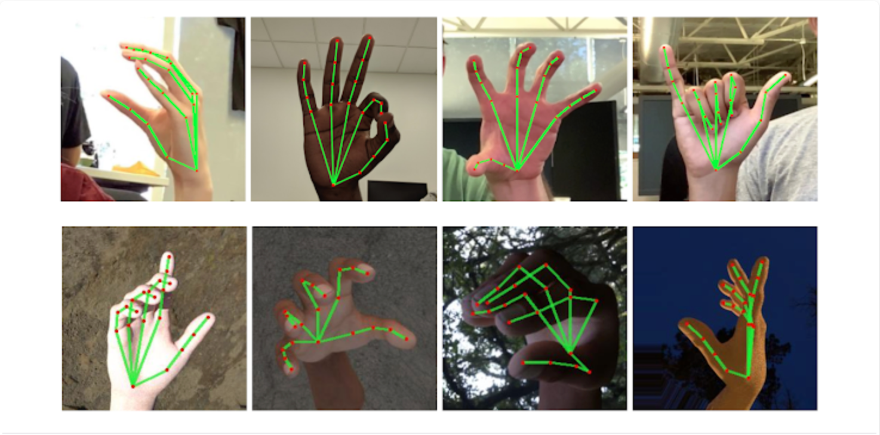

Slide 12
Library used
Level : 2
Mediapipe:
MediaPipe offers open source cross-platform, customizable ML solutions for live and streaming media.
Holistic model:
The MediaPipe Holistic pipeline integrates separate models for pose, face and hand components, each of which are optimized for their particular domain.
OpenCV:
OpenCV (Open Source Computer Vision Library) is a library of programming functions mainly aimed at real-time computer vision.
SciKit Learn:
Scikit-learn is a free machine learning library for Python. It features various algorithms like support vector machine, random forests, and k-neighbours, and it also supports Python numerical and scientific libraries like NumPy and SciPy .

Slide 13
Implementation approach:
STEP 1 => Make Detections
STEP 2 => Capture Landmarks & Export to CSV
STEP 3 => Train Custom Model Using Scikit Learn
Read in Collected Data and Process
Train Machine Learning Classification Model
Evaluate and Serialize Model
STEP 4 => Make Detections with Model

Slide 14
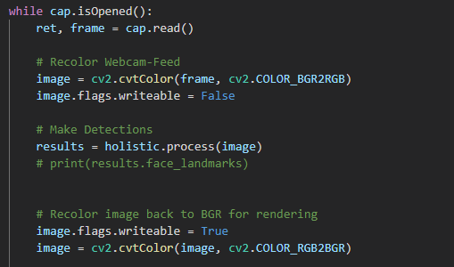
Make Detections
Default feed from OpenCV is in BGR format
but we need it in RGB format to work with
Mediapipe. Later after processing we convert
It back to BGR to render on screen.

Slide 15
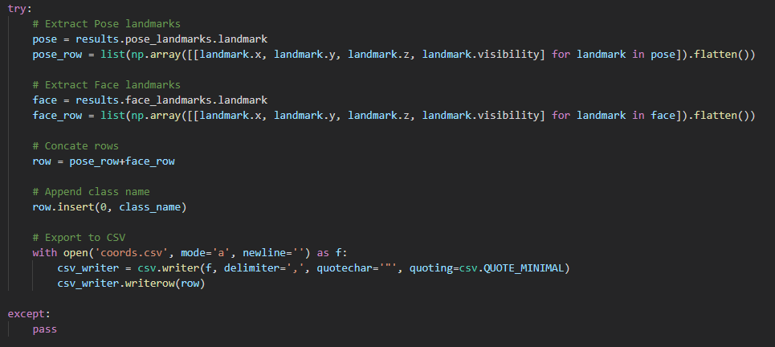
Capture Landmarks & Export to CSV
While capturing frame by frame
we now export the coordinates and
visibility for these coordinates to our
CSV file.

Slide 16

Train Custom Model Using Scikit Learn
Target is what we are trying to predict i.e Pose. (Y)
Features is what information we are using to predict the Target i.e Coordinates. (X)
Splitting the data we got into train and test with 30% data used for testing.

Slide 17
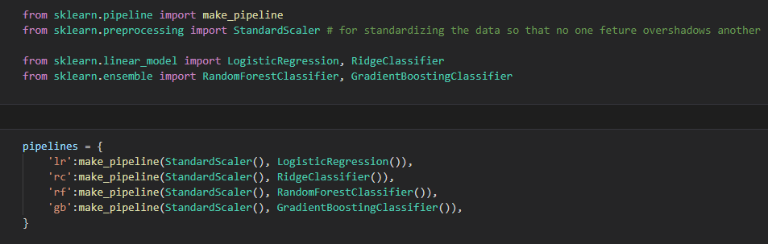
Train Custom Model Using Scikit Learn
Creating pipelines for different Models and setting them up

Slide 18
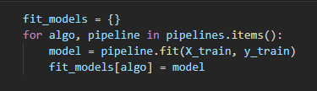
Train Custom Model Using Scikit Learn
Training the Models using our x_train and y_train data.

Slide 19
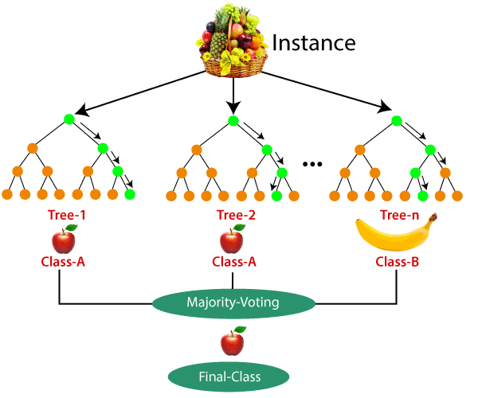
Random Forest Classifier
Random Forest works in two-phase first is to create the random forest by combining N decision tree, and second is to make predictions for each tree created in the first phase.
The Working process can be explained in the below steps and diagram:
Step-1: Select random K data points from the training set.
Step-2: Build the decision trees associated with the selected data points (Subsets).
Step-3: Choose the number N for decision trees that you want to build.
Step-4: Repeat Step 1 & 2.
Step-5: For new data points, find the predictions of each decision tree, and assign the new data points to the category that wins the majority votes.

Slide 20
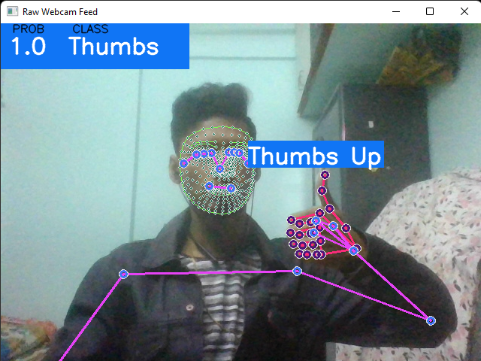
Make Detections with Model

Slide 21
Potential Useful Applications
Sign language detection
Virtual reality
Gaming
Better screening in online Interviews
Criminal Interrogations
Court Witnesses

